Slide 1
Aerodynamic design of an axial fan stage TEAGAN kILIAN

Slide 2
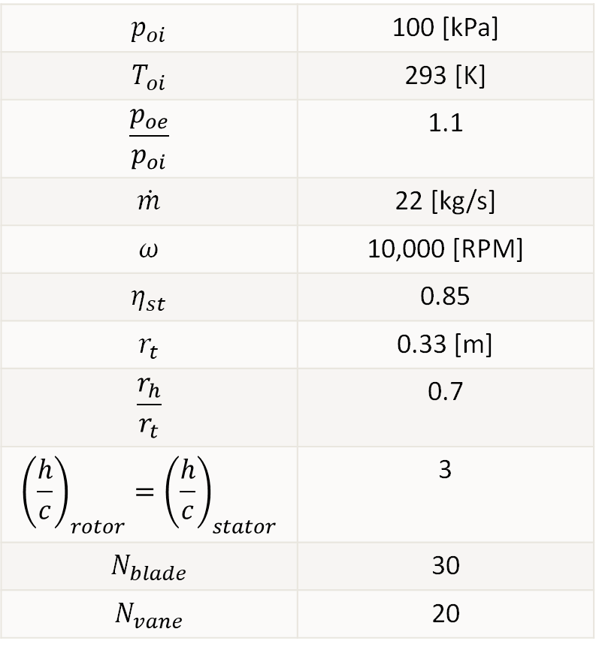
Design Requirements
$$p_{oi}$$ | 100 [kPa]
$$T_{oi}$$ | 293 [K]
$$\frac{p_{oe}}{p_{oi}}$$ | 1.1
$$\dot{m}$$ | 22 [kg/s]
$$ω$$ | 10,000 [RPM]
$$η_{st}$$ | 0.85
$$r_{t}$$ | 0.33 [m]
$$\frac{r_{h}}{r_{t}}$$ | 0.7
$${\left(\frac{h}{c}\right)}_{rotor}={\left(\frac{h}{c}\right)}_{stator}$$ | 3
$$N_{blade}$$ | 30
$$N_{vane}$$ | 20

Slide 3
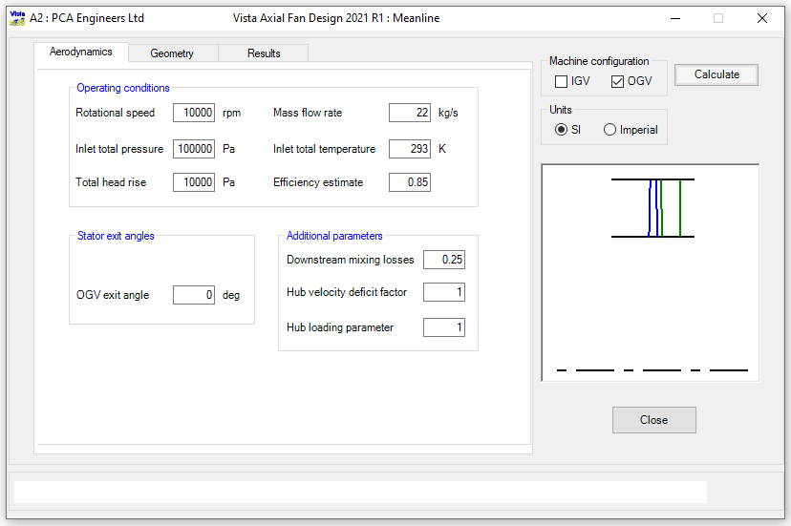
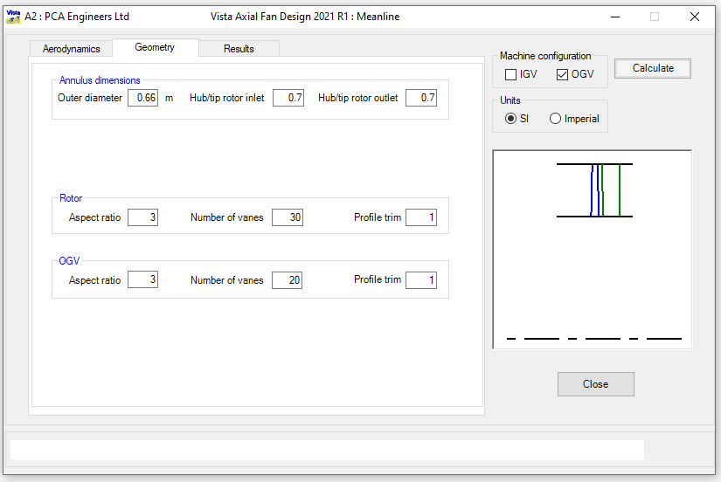
Ansys vista afd inputs

Slide 4
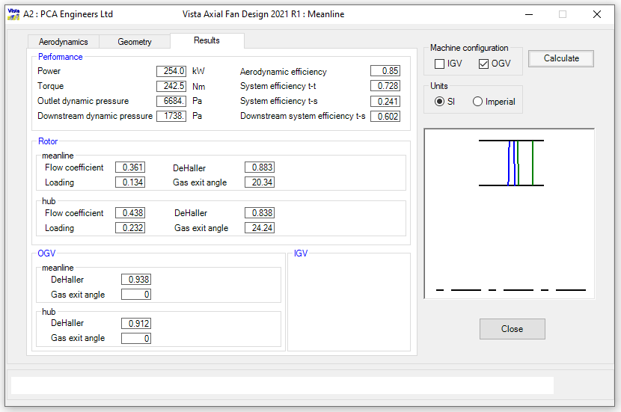
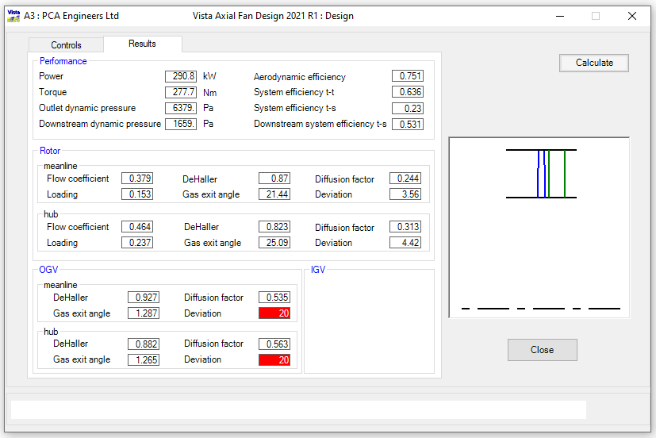
Ansys vista afd results: Mean line and design

Slide 5
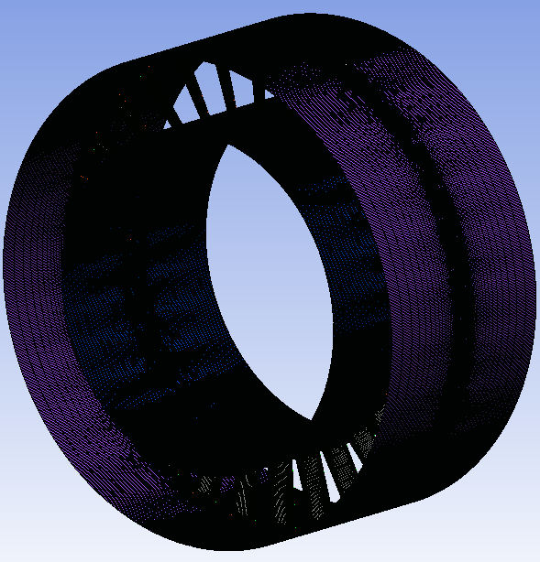
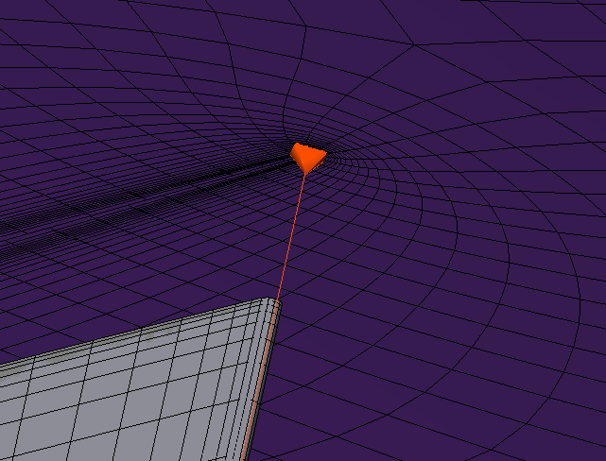
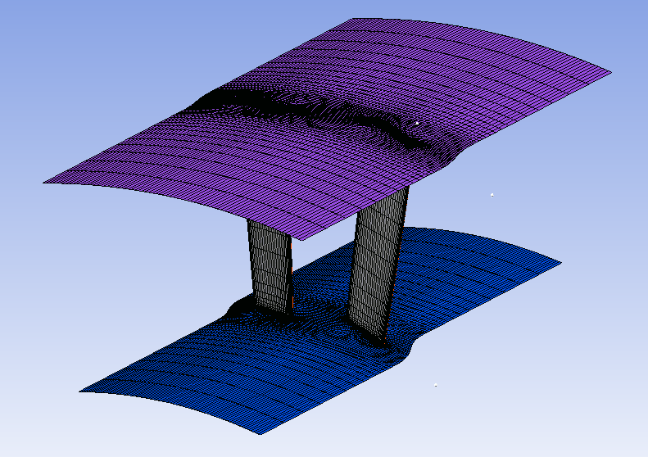
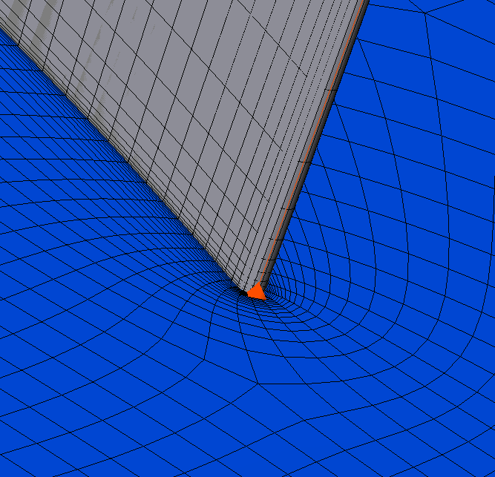
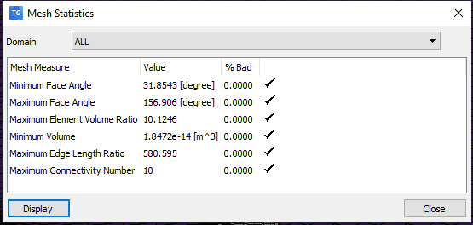
Turbo-grid mesh

Slide 6
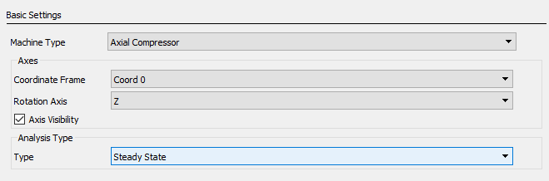
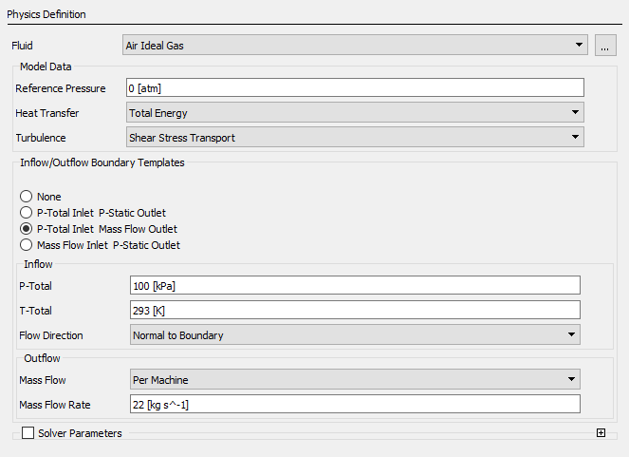
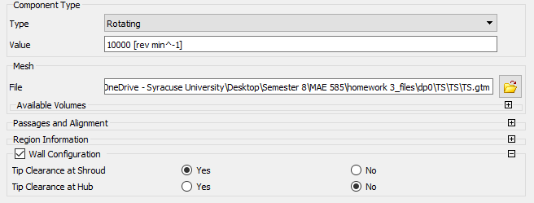
Boundary conditions in ansys cfx

Slide 7
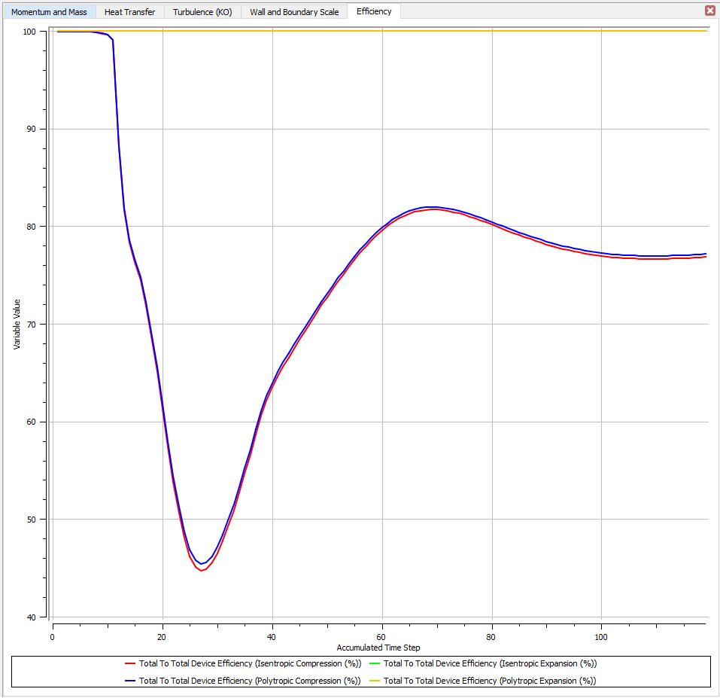
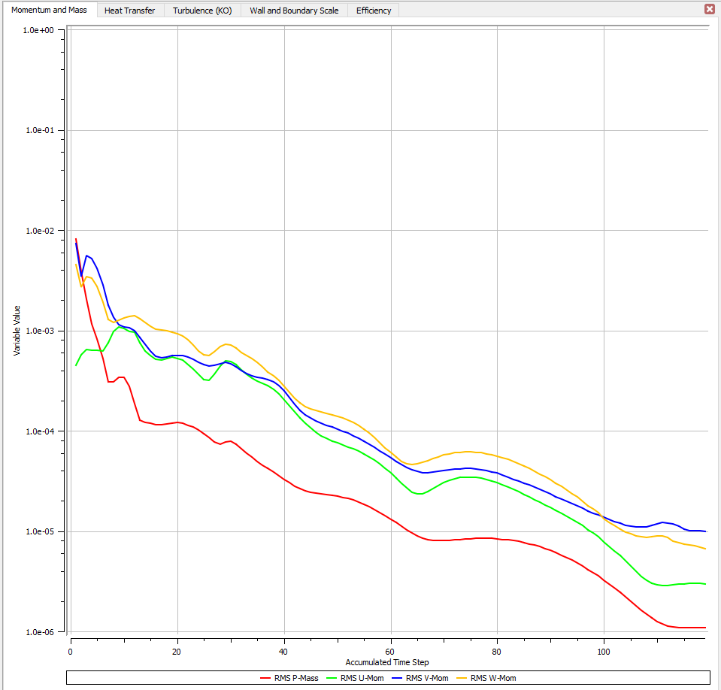
Cfx-solver: convergence plot
Momentum and Mass Plot
Efficiency Plot

Slide 8
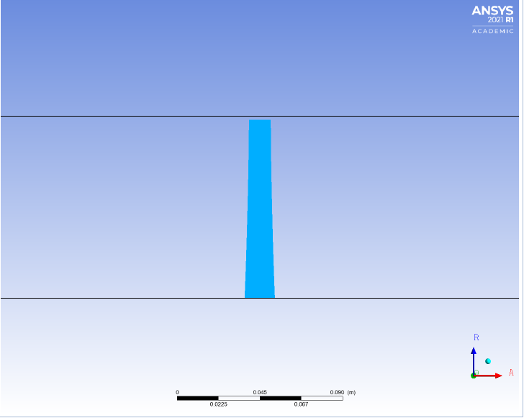
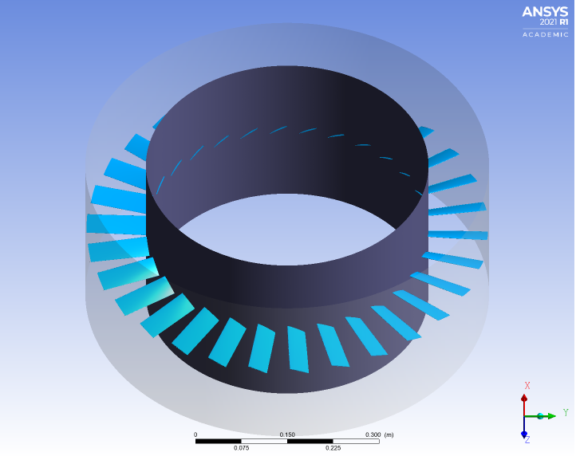
Results from cfd-post
Meridional View of the Blade, Hub, and Shroud
3D View of Blade, Hub, and Shroud

Slide 9
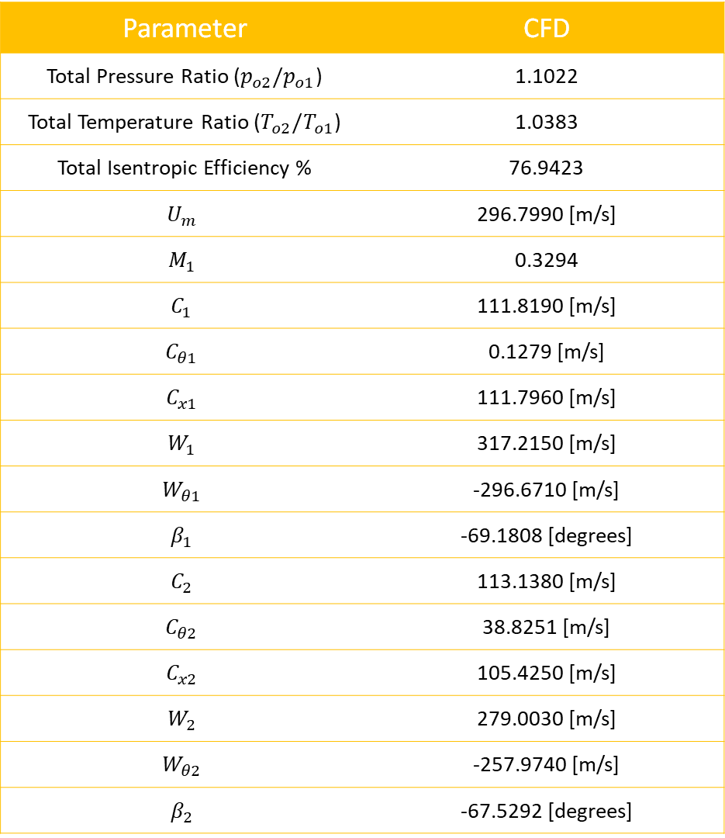
Parameter | CFD
Total Pressure Ratio ($p_{o2}/p_{o1}$) | 1.1022
Total Temperature Ratio ($T_{o2}/T_{o1}$) | 1.0383
Total Isentropic Efficiency % | 76.9423
$$U_{m}$$ | 296.7990 [m/s]
$$M_{1}$$ | 0.3294
$$C_{1}$$ | 111.8190 [m/s]
$$C_{θ1}$$ | 0.1279 [m/s]
$$C_{x1}$$ | 111.7960 [m/s]
$$W_{1}$$ | 317.2150 [m/s]
$$W_{θ1}$$ | -296.6710 [m/s]
$$β_{1}$$ | -69.1808 [degrees]
$$C_{2}$$ | 113.1380 [m/s]
$$C_{θ2}$$ | 38.8251 [m/s]
$$C_{x2}$$ | 105.4250 [m/s]
$$W_{2}$$ | 279.0030 [m/s]
$$W_{θ2}$$ | -257.9740 [m/s]
$$β_{2}$$ | -67.5292 [degrees]
Results from cfd-post

Slide 10
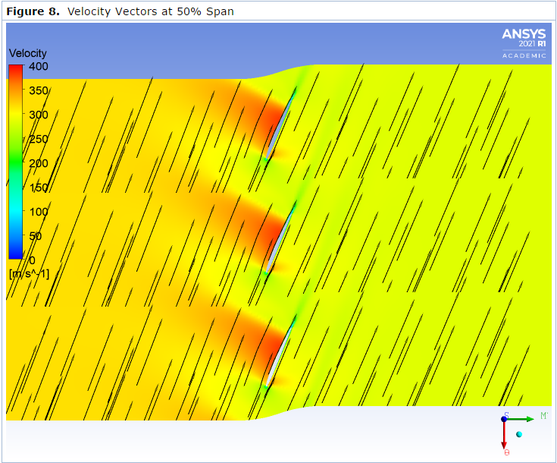
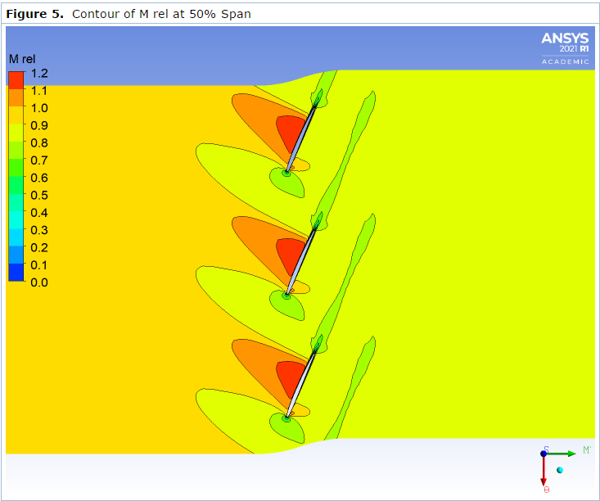
Results from cfd-post
At 50% span, there are portions of the flow that reach flow speeds greater than the speed of sound. This is evident because the top side of the blade depicts a Mach number that is greater than 1. Additionally, the velocity in the same place reaches speeds up to 400 m/s as the air flows along the blade. The design is robust because as shown by the direction of flow, the air moves along the blade which is favorable and more efficient. This also indicates that there is no flow separation. There is evidence that there will be shock waves inside of the flow field since shock waves are produced when air speeds overcome the speed of sound.

Slide 11
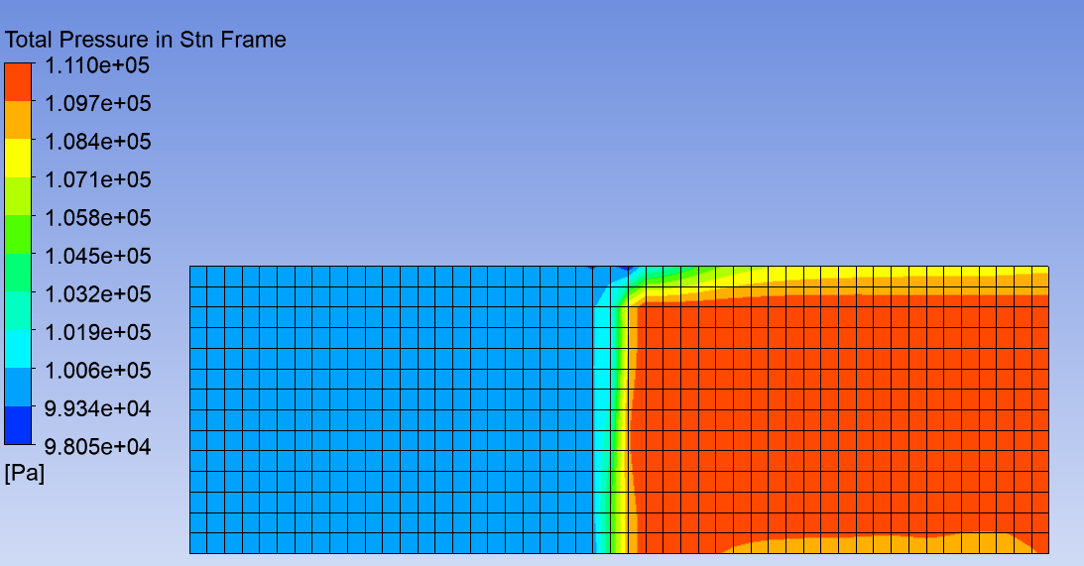
Results from cfd-post
The result showing a lower pressure on the left side of the blade and a higher pressure on the right side of the blade because the pressure difference is what causes the blades to rotate. The difference in pressure on the blade provides a greater force on one side of the blade compared to the other side.
The work done by the compressor on the high-pressure side of the blade is not uniform span wise because the pressure distribution is not uniform. To make the work more uniform and increase the efficiency of the compressor, one should soften and round the edges of the blade.

Slide 12
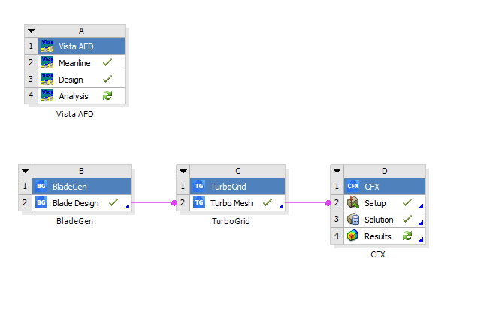
Workbench

